Slide 1









HTML 1
www.jiangren.com.au

Slide 2

Introduction
Graduated from Monash CS.
Worked at Telstra, Nab, ANZ, sportsbet and currently afterpay.
Full-stack engineer with a focus on JS.
LinkedIn - https://www.linkedin.com/in/jing-zhou-743201160/

Slide 3
Objectives
HTML introduction
HTML basic elements
Introduction to CSS and basic properties
Progressive project for practice

Slide 4

HTML
What is HTML (NOT How to Meet Ladies)
HyperText Markup Language
Key word Markup – used by web developers to structure and describe the content of a webpage (not a programming language)
HTML is consists of elements that describe different types of contents: paragraphs, links, headings, images, video, etc.

Slide 5
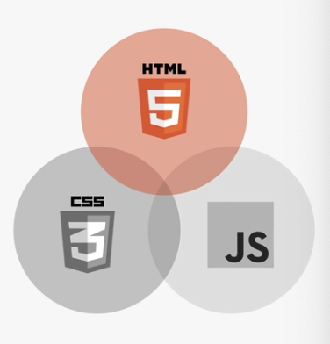
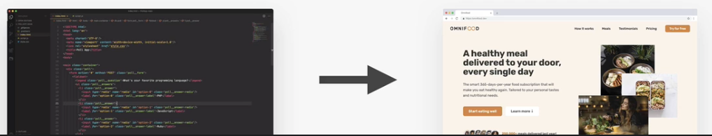
HTML, CSS and JavaScript Explained

Slide 6
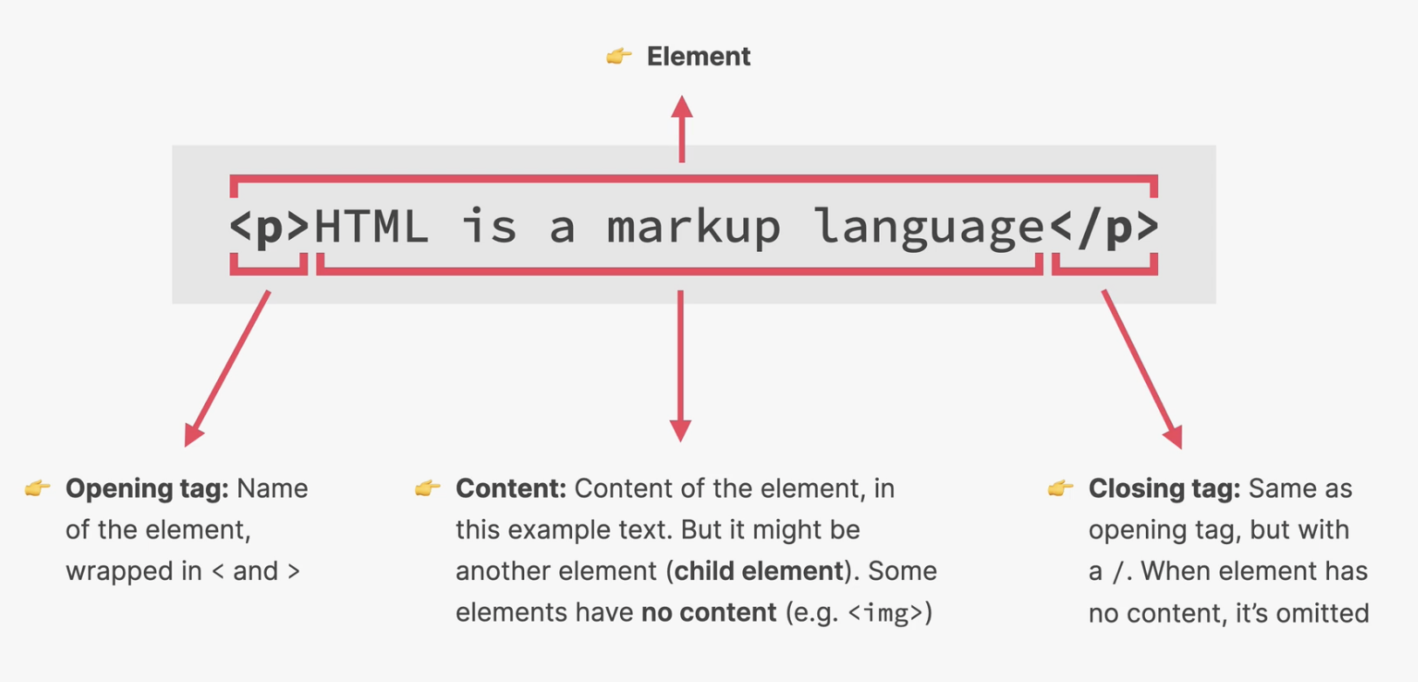
HTML Element

Slide 7


Slide 8
Your Best Friend
W3Schools: w3schools.com/html/
MDN: https://developer.mozilla.org/en-US/

Slide 9
HTML
HTML structure and define content semantically.
Element
<h1> This is header </h1>
Opening Tag
Content
Closing Tag
Element with attribute
<h1 style=“color:blue;”> This is header </h1>
Opening Tag
Attribute
Content
Closing Tag

Slide 10
Personal Website
https://australiaitgroup.github.io/jrprofile/#home
https://github.com/australiaitgroup/jrprofile

Slide 11





Structure
<!DOCTYPE html>
<html>
<head>
<title>Title</title>
</head>
<body>
<div>Content</div>
</body>
</html>
Doc Type
Head
Body

Slide 12
HTML Basics
<!DOCTYPE html>
<html>
<head>
<title>Title</title>
</head>
<body>
<div>Content</div>
</body>
</html>
Document Type Declaration
Doc Type
An instruction to the web browser about what version of HTML the page is written in.
Head
Tips: Always on Top
HTML5
<!DOCTYPE
html>
Body
HTML4
<!DOCTYPE
HTML PUBLIC
"-//
W3C//DTD HTML 4.01//EN"
"http://www.w3.org/TR/ html4/strict.dtd">
Notes:
Favicon

Slide 13
HEAD
<!DOCTYPE html>
<html>
<head>
<title>Title</title>
</head>
<body>
<div>Content</div>
</body>
</html>
Head is used for the information about the document but NOT showing to user in the content area.
Doc Type
Head
Title , Language, Viewport , Favicon CSS and Javascript etc.
e.g.
<title>title on Browser</title>
<meta charset=“utf-8">
Body
For SEO
Meta title
Meta Keywords
Meta Description

Slide 14
BODY
<!DOCTYPE html>
<html>
<head>
<title>Title</ title>
</head>
<body>
<div>Content</div>
</body>
</html>
Body is the content of the all the elements to show.
<h1> This is Header </h1>
<a href=“http://
jiangren.com.au">匠人圈</a>
<button type="button">Click Me!
</button>
Doc Type
Head
Body

Slide 15
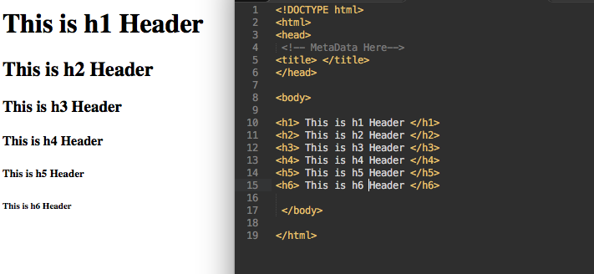
Text - Header
Header is define structure the hierarchy of the content
Semantic for Search Engine Optimisation and Friendly for disabled
Notes:
查看个人网站

Slide 16
SEO
Only one H1 for one page
Page Structure
H1
H2
H2
H3
H3
H4
H4
H4
H5
H5
H5
H6
H6
H6
Notes:
查看个人网站

Slide 17
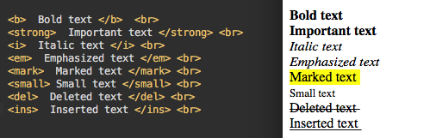
Text - Format element

Slide 18
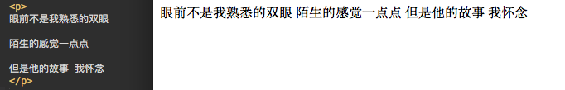
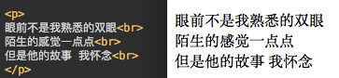
Paragraph

Slide 19
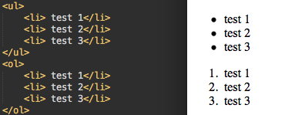
List
UL = Unsorted List
OL = Ordered List
Notes:
Navigation

Slide 20
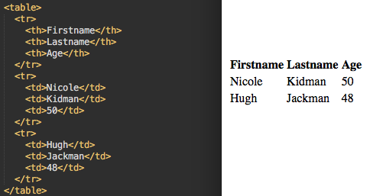
Table
https://web.archive.org/

Slide 21

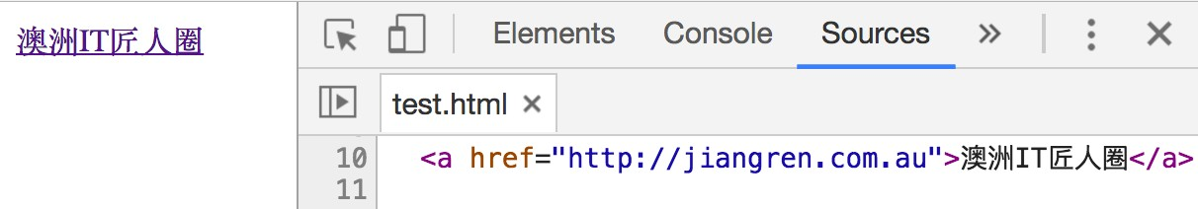
Link
Link is a inline element by default
<a href="http://jiangren.com.au">澳洲IT匠人 圈</a>

Slide 22
Link
<a href="http://jiangren.com.au" target="_blank" >澳洲IT匠 ⼈ 圈</a>
Value | Description
_blank | Opens the linked document in a new window or tab
_self | Opens the linked document in the same frame as it was clicked (this is default)
_parent | Opens the linked document in the parent frame
_top | Opens the linked document in the full body of the window
framename | Opens the linked document in a named frame
https://www.w3schools.com/tags/tag_a.asp

Slide 23

Img
<img
src=“”
alt=“” />
./ vs ../ vs /

Slide 24
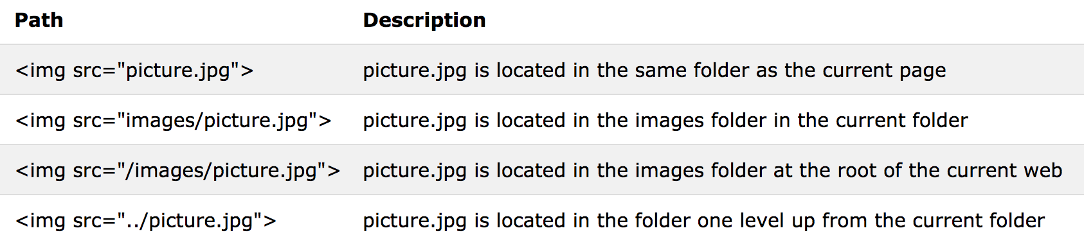
File Path

Slide 25
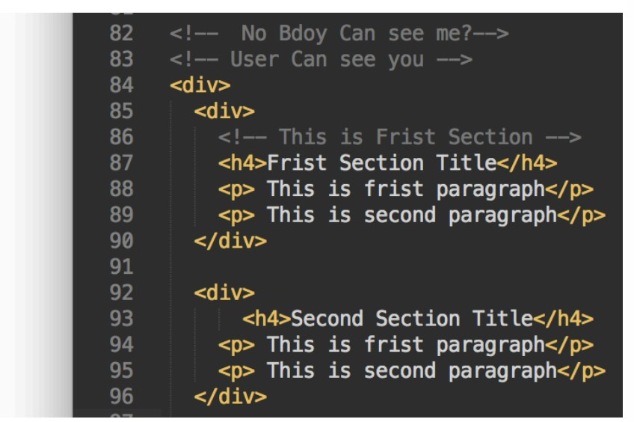
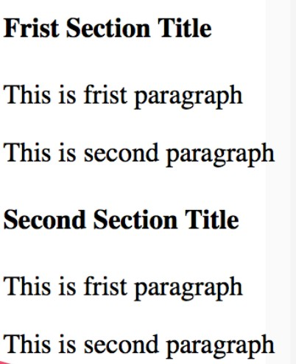
Comment
<!--
comment -->

Slide 26
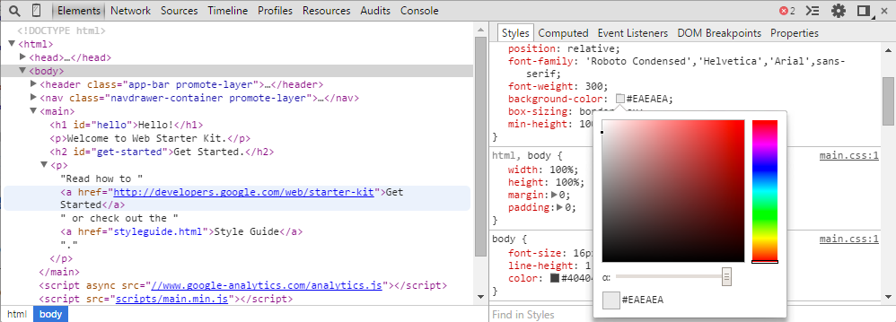

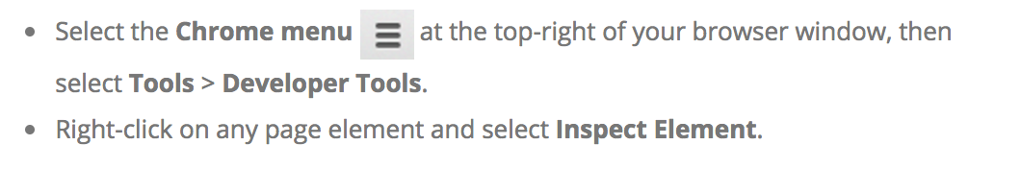
Chrome Dev Tool
How to Access DevTools
Npm install live-server -g

Slide 27
Block vs Inline
Block Elements
Inline Elements
Block 1 Block 2
Block 3 Block 4

Slide 28
Block Elements
Inline Elements
<div> <header> <main>
<footer> <h1-6> <p>
<table> <form> <hr>
<nav>
<section>
<ol> <li>
<a> <br> <button> <img>
<label> <span> <script>
<textarea> <b> <strong>
<input>
<ul>
<select>
<em> <i>
<canvas> <video> <output> <pre> <dd>
<dl> <dt> <address> <article> <aside>
<abbr> <acronym>
<bdo>
<big> <cite>
<code> <dfn> <kbd>
<q> <samp> <small>
<map>
<sub>
<object>
<sup>
<blockquote> <figure> <figcaption>
<noscript>
<fieldset>
<time> <tt>
<var>

Slide 29
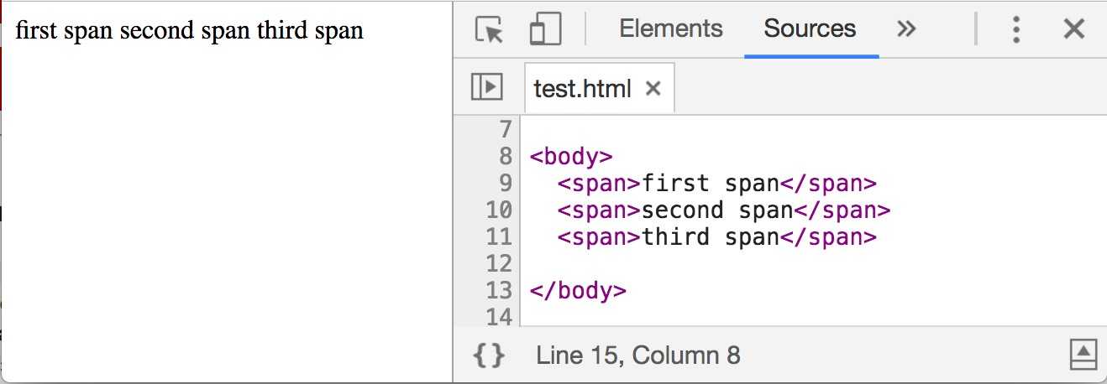
Span
span is a inline element by default.

Slide 30

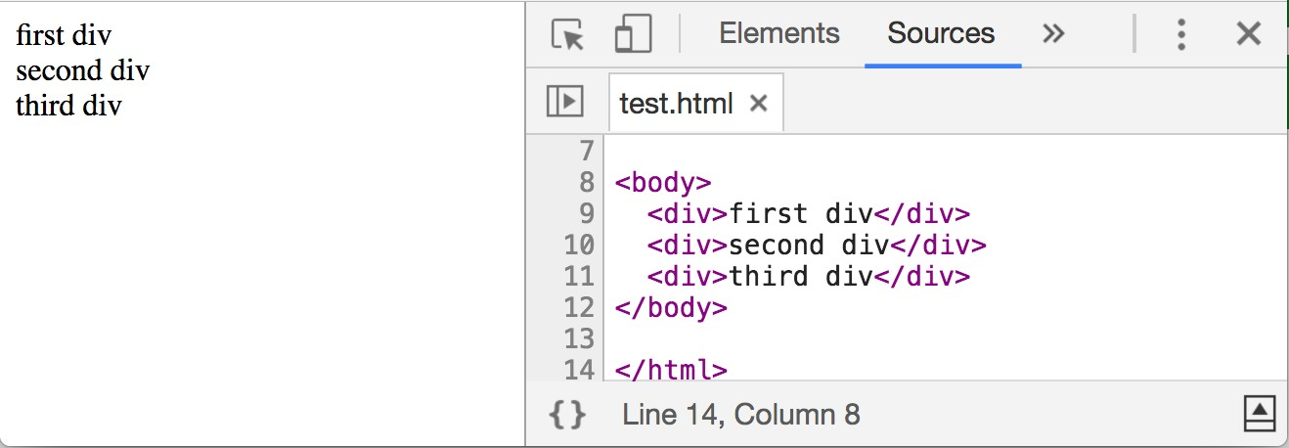
Block - <div>
div is a block element by default.

Slide 31
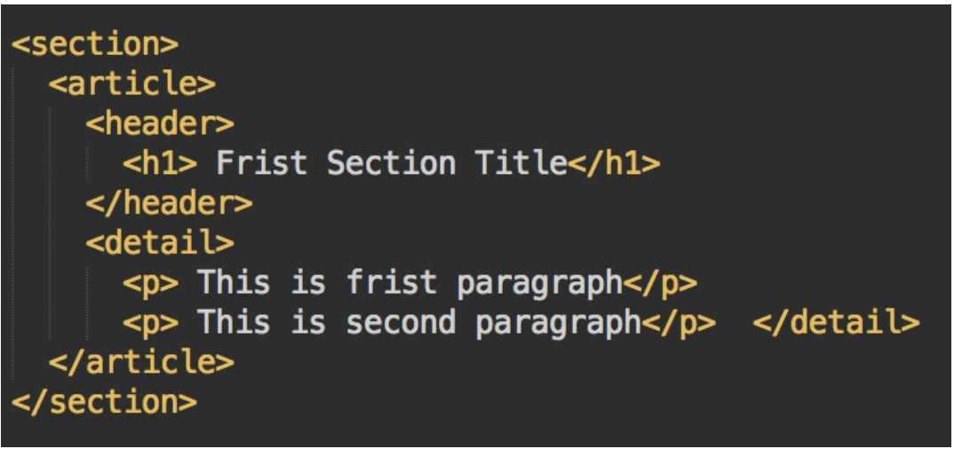
HTML5 Semantic

Slide 32

HTML5 Semantic - img

Slide 33
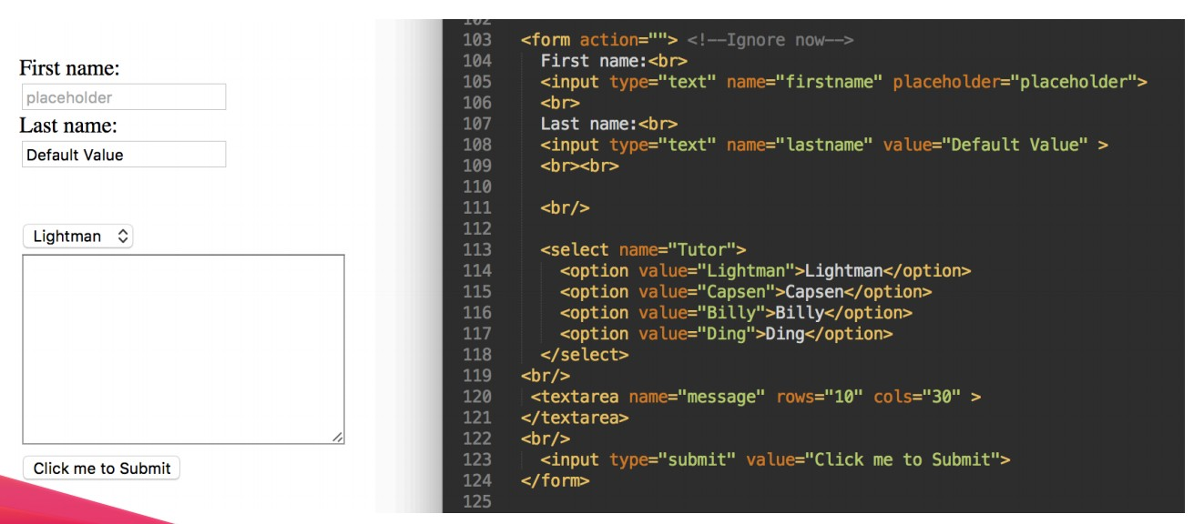
Form & Input

Slide 34
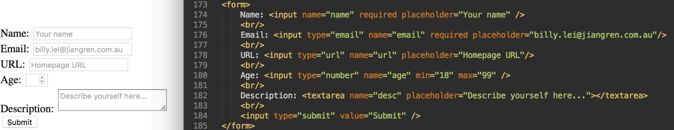
HTML5 Input

Slide 35
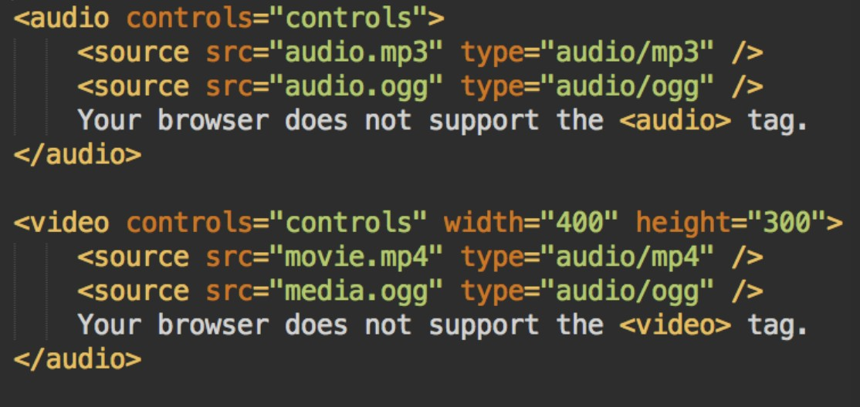
HTML5 Media
ff
<svg>
& <canvas>
& WebGL

Slide 36
HTML Best Practices
HTML has a lot of similar elements. For example, p and div are very similar. But keep all the contents inside a meaningful tag.
Indentation makes HTML more easy to read.
Remembering some useful short-cut of few editors speeds up development.
Syntax highlighted editor helps you to find the errors.

Slide 37
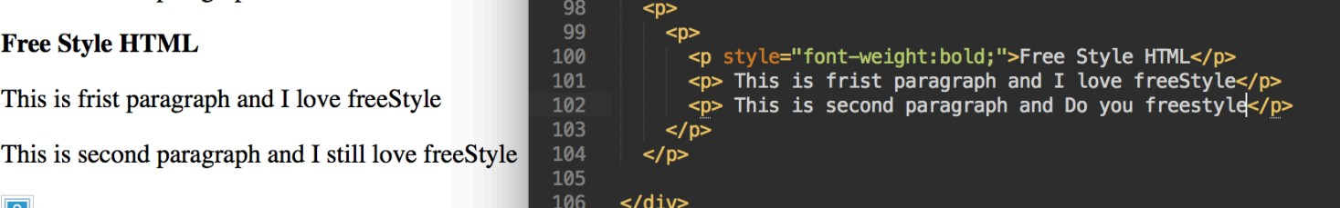
HTML Best Practices - Bad example

Slide 38
HTML Interview Questions
goskills.com/Development/Articles/HTML-interview-questions-answers

Slide 39
Further Readings
Code Academy: Introduction to HTML codecademy.com/learn/learn-html
Interactive tutorials: learn-html.org
BLACK VOODOO MAGIC: codepen.io
Notes:
HTML Assignments

